Slide 1
Visualizing the effect of temperature, fossil fuels on Climate Change
By Team N

Slide 2
Overview:
Our project is based on the climate change and the factors behind it.
Climate change refers to long-term shifts in temperatures and weather patterns. These shifts may be natural, but since the 1800s, human activities have been the main driver/cause of climate change, primarily due to the burning of fossil fuels (like coal, oil, and gas) which produces heat-trapping gases.
Industrial activities and emission of greenhouse/heat-trapping gases are a cause of increase in temperature.
Climate change is one of the most serious issue faced by humans today and will be in future.

Slide 3
Objectives
Top 15 Countries affected by the temperature change both developed and developing.
Analyzing the temperature change patterns of developed and developing countries.
Analyzing the consumption of fossil fuels in these countries and its relation to Temperature change.
Analyzing the effects of all 4 season on temperature change.
Analyzing the effect of seasons on Temperature change in developed and developing countries.

Slide 4
Theory Implementation
Implemented Tufte’s Principles.
Used Dashboards in tableau and PowerBI to provide the overview of the visuals and later on get details upon clicking them.
Visualizations in dash follows the magnifying/zoom concepts.
Dash visuals follow scrolling
Implemented Treemap to represent the hierarchical data of temperature change during different seasons.
Focus and Context
Much More

Slide 5
Tools Used Python (Pandas, NumPy, Spyder) Plotly Dash Power-Bi Tableau Excel Anaconda Jupyter Notebooks Treemap-4.1.2 etc

Slide 6
Data Source
Food and Agriculture organization (FAO) of the United Nations’ Temperature change
https://www.fao.org/faostat/en/#data/ET
World bank’s Fossil fuel energy consumption
https://data.worldbank.org/indicator/EG.USE.COMM.FO.ZS

Slide 7
Data Cleaning/Processing
Used Pandas and Microsoft Excel for the processing of data.
Python code for data processing is present in below notebooks Fossil_Fuel_DP.ipynb and Temp_Change_DP.ipynb

Slide 8
Challenges with data
Large amount of raw data needed extensive amount of time for cleaning.

Slide 9
Tableau
Used Tableau Public for Visualizing the data.
The file Info_Viz_Project.twbx can be used for the visuals.

Slide 10
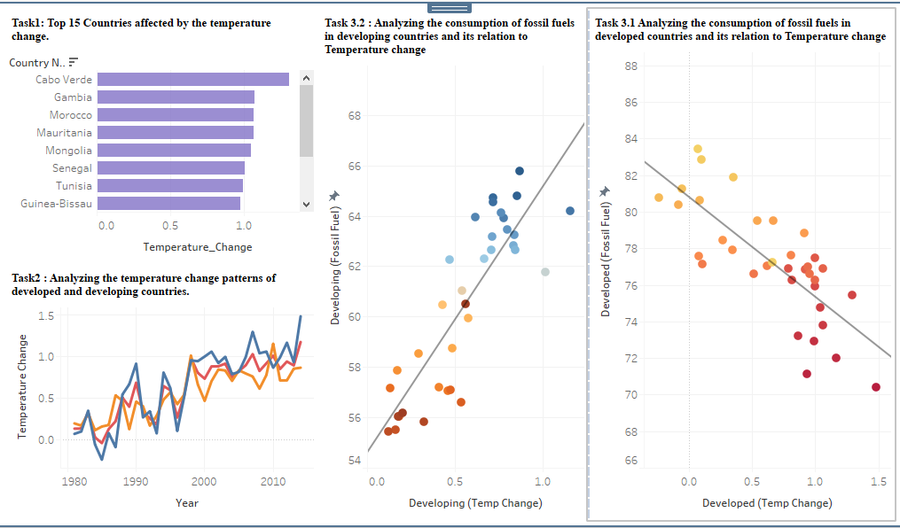

Slide 11
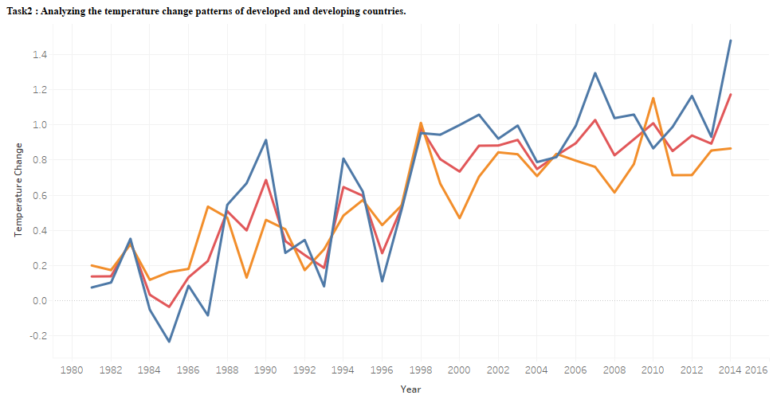

Slide 12
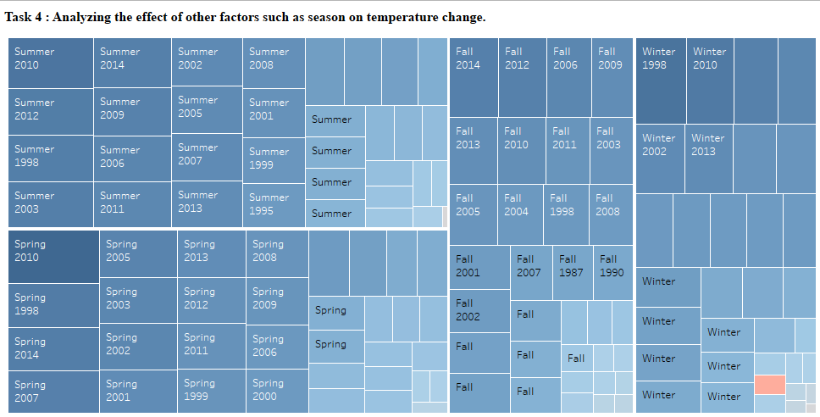

Slide 13
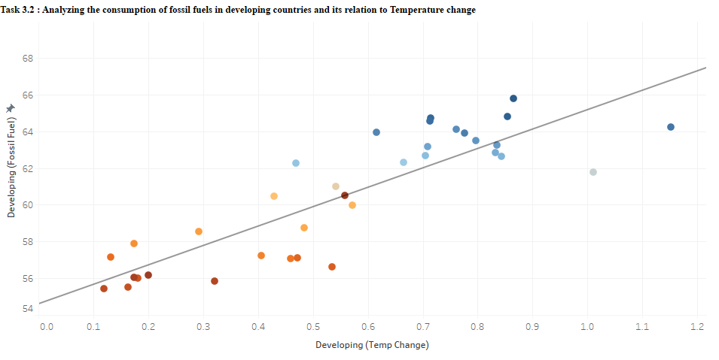

Slide 14
Limitations of Tableau.
Less customizations.
Has overwhelming features.
Time consuming to get started with the visuals.

Slide 15
Power BI
Used PowerBI for visualization of the data.
Info_Viz_Project.pbix file is created by PowerBI for visuals.

Slide 16
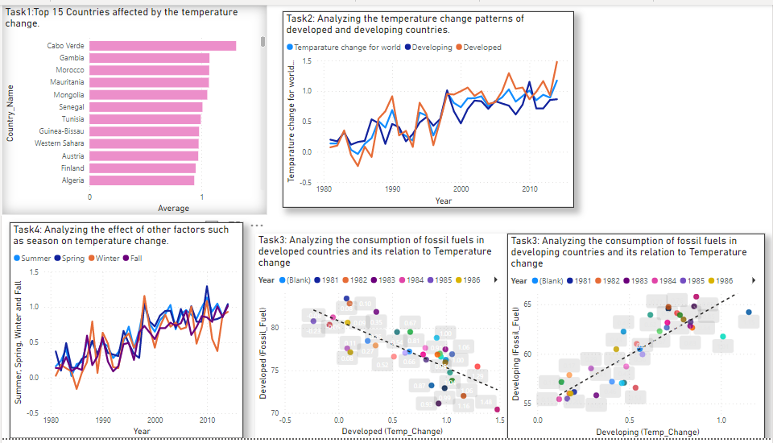

Slide 17
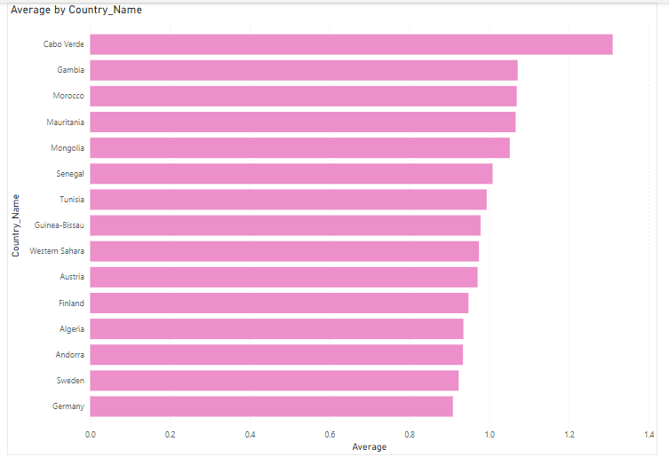
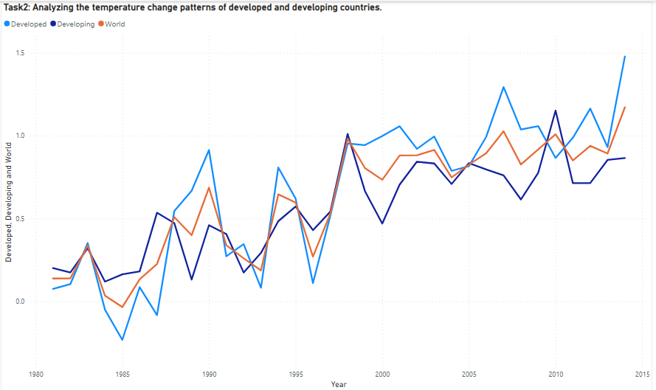

Slide 18
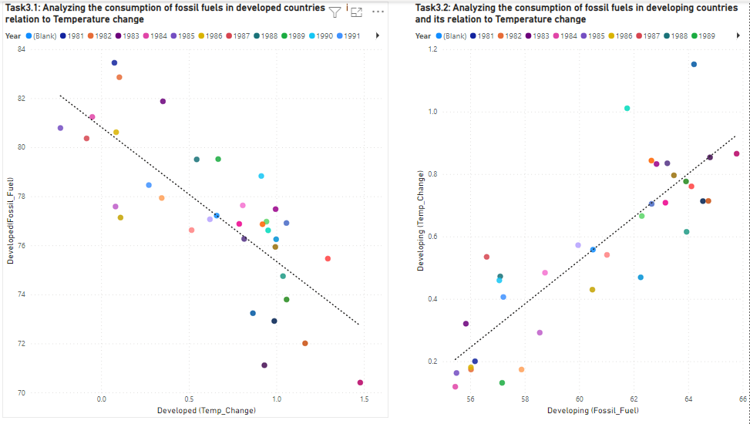

Slide 19
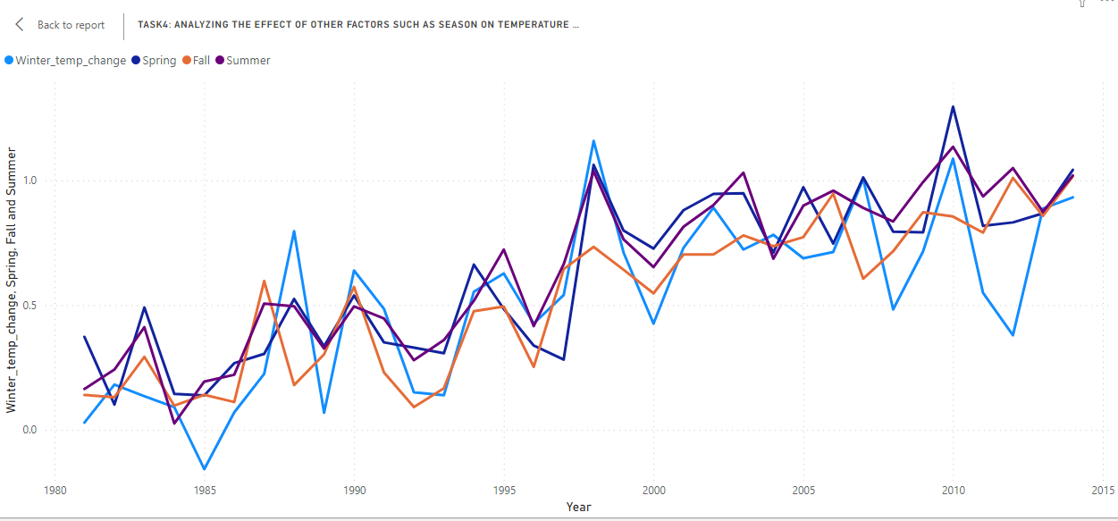

Slide 20
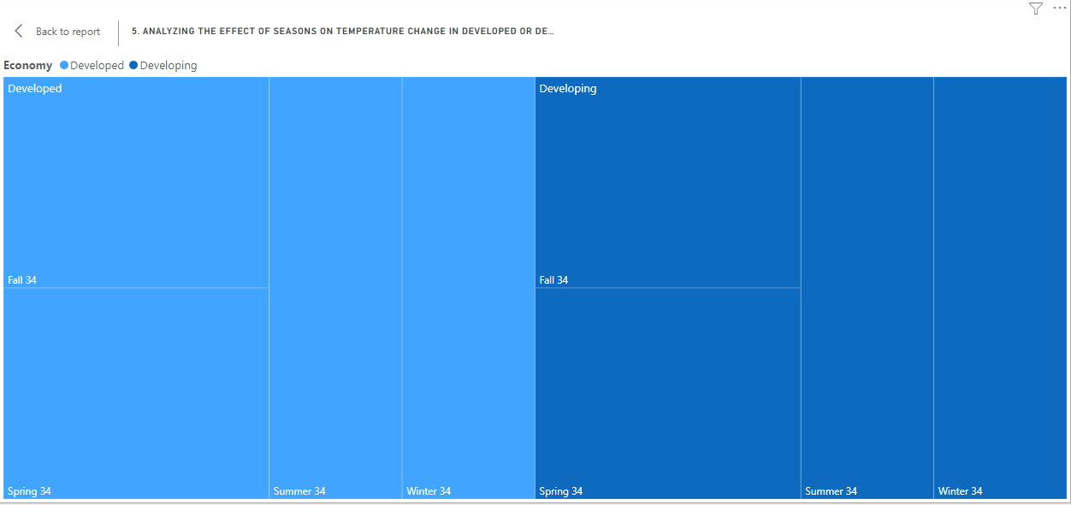

Slide 21
Limitations of PowerBI
1. Not ideal for Treemaps.
2. Handling Large Data Volumes
3. Crowded user interface

Slide 22
Plotly Dash
Used Dash python Library from Plotly for the visualizations.
The code for this visualizations is written in Info_Viz_Project.py.
Dash:
Dash is a python framework created by plotly for creating interactive web applications.
Written on top of Plotly.js and React.js, Dash is ideal for building and deploying data apps with customized user interfaces. It's particularly suited for anyone who works with data.

Slide 23
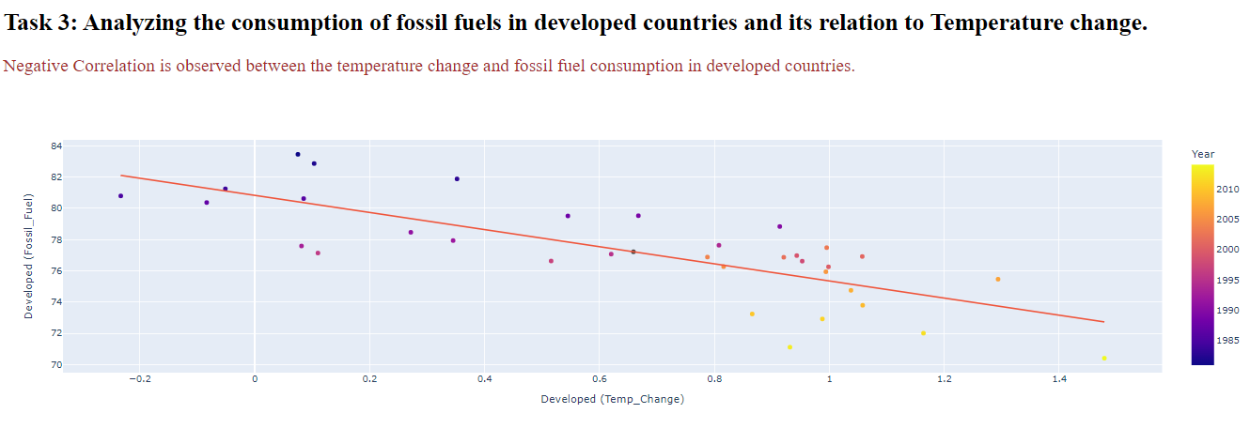

Slide 24
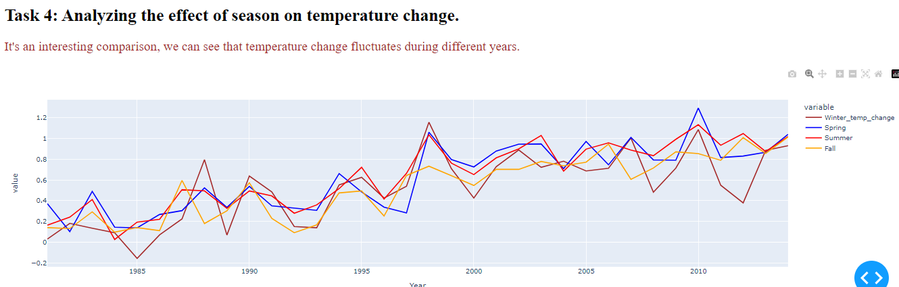

Slide 25
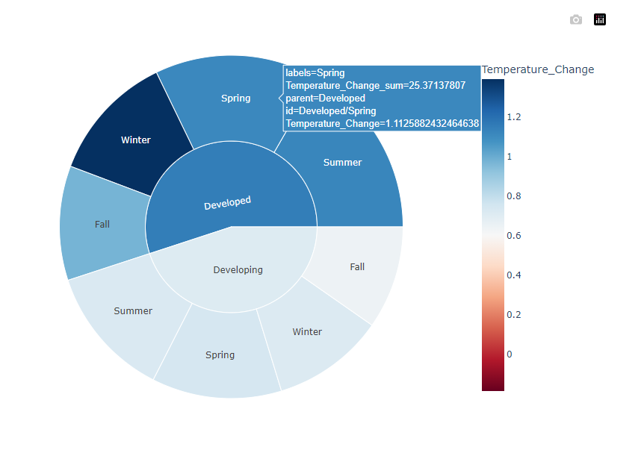

Slide 26
Limitations of Dash
Not able to plot useful Treemaps.
Requires coding (+/-).

Slide 27
Treemap-4.1.2
Treemap-4.1.2 is a Treemap visualization software developed by Human Computer Interaction Laboratory (HCIL), University of Maryland.
Treemaps created by this tool are very useful. Some samples are provided in the below slides.

Slide 28
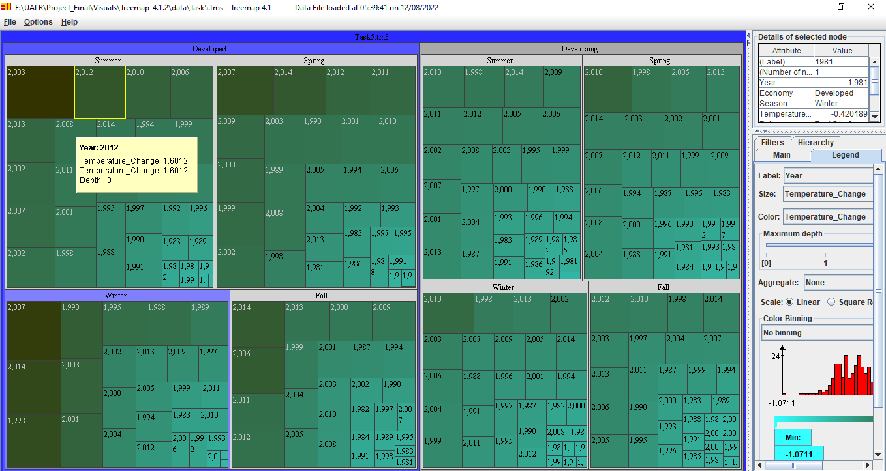

Slide 29
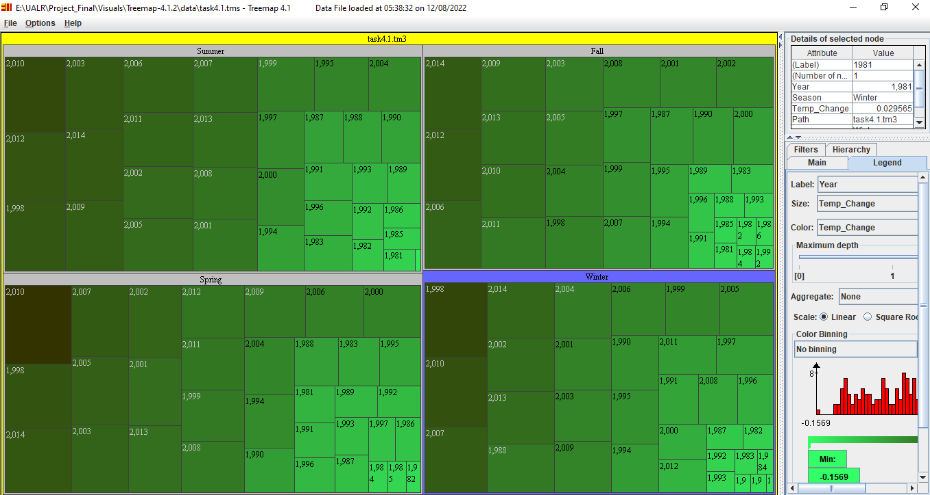

Slide 30
Which visualization tool is better?
All the tools were useful in some kind or other and I believe the solution for our project comes from
taking the best of them.
In our project:
Dash is better for visualizing the scatterplots, line charts with multiple lines, sunburst charts.
PowerBI was useful in line charts and scatterplots.
Tableau is good for line charts, scatterplots and some what for Treemaps.
Treemap-4.1.2 is best for Treemaps visualizations.

Slide 31
Thank You !!

